Slide 1

Slide-A-Round Math Manipulatives
Jim Franklin

Slide 2
Background
Created by a veteran special education teacher with 25+ years in the classroom
Available for ALL students including blind and visually impaired
Currently utilized by students in 43 states

Slide 3
Why are manipulatives/models an effective tool?
Models for various numbers (small whole numbers, multi-digit numbers and decimals, fractions and percents, integers) should be introduced to students early on in the development of these number systems. Models are simply pedagogical conventions that have been invented to represent numbers. They make sense to us because we already understand the ideas that the model represents.
John Van de Walle, Author of Teaching Developmentally

Slide 4
What do you have to teach rounding?
How do you teach students to round numbers up to 10,000,000?
What do you do when your 1-100 number line isn’t enough?
How do you differentiate your instruction in a class with multiple ability levels?

Slide 5
Decision-Making Guide - What are your instructional needs?
https://drive.google.com/file/d/0B0tPuWXl7g3-eE1zcmNrWklXQzg/view

Slide 6
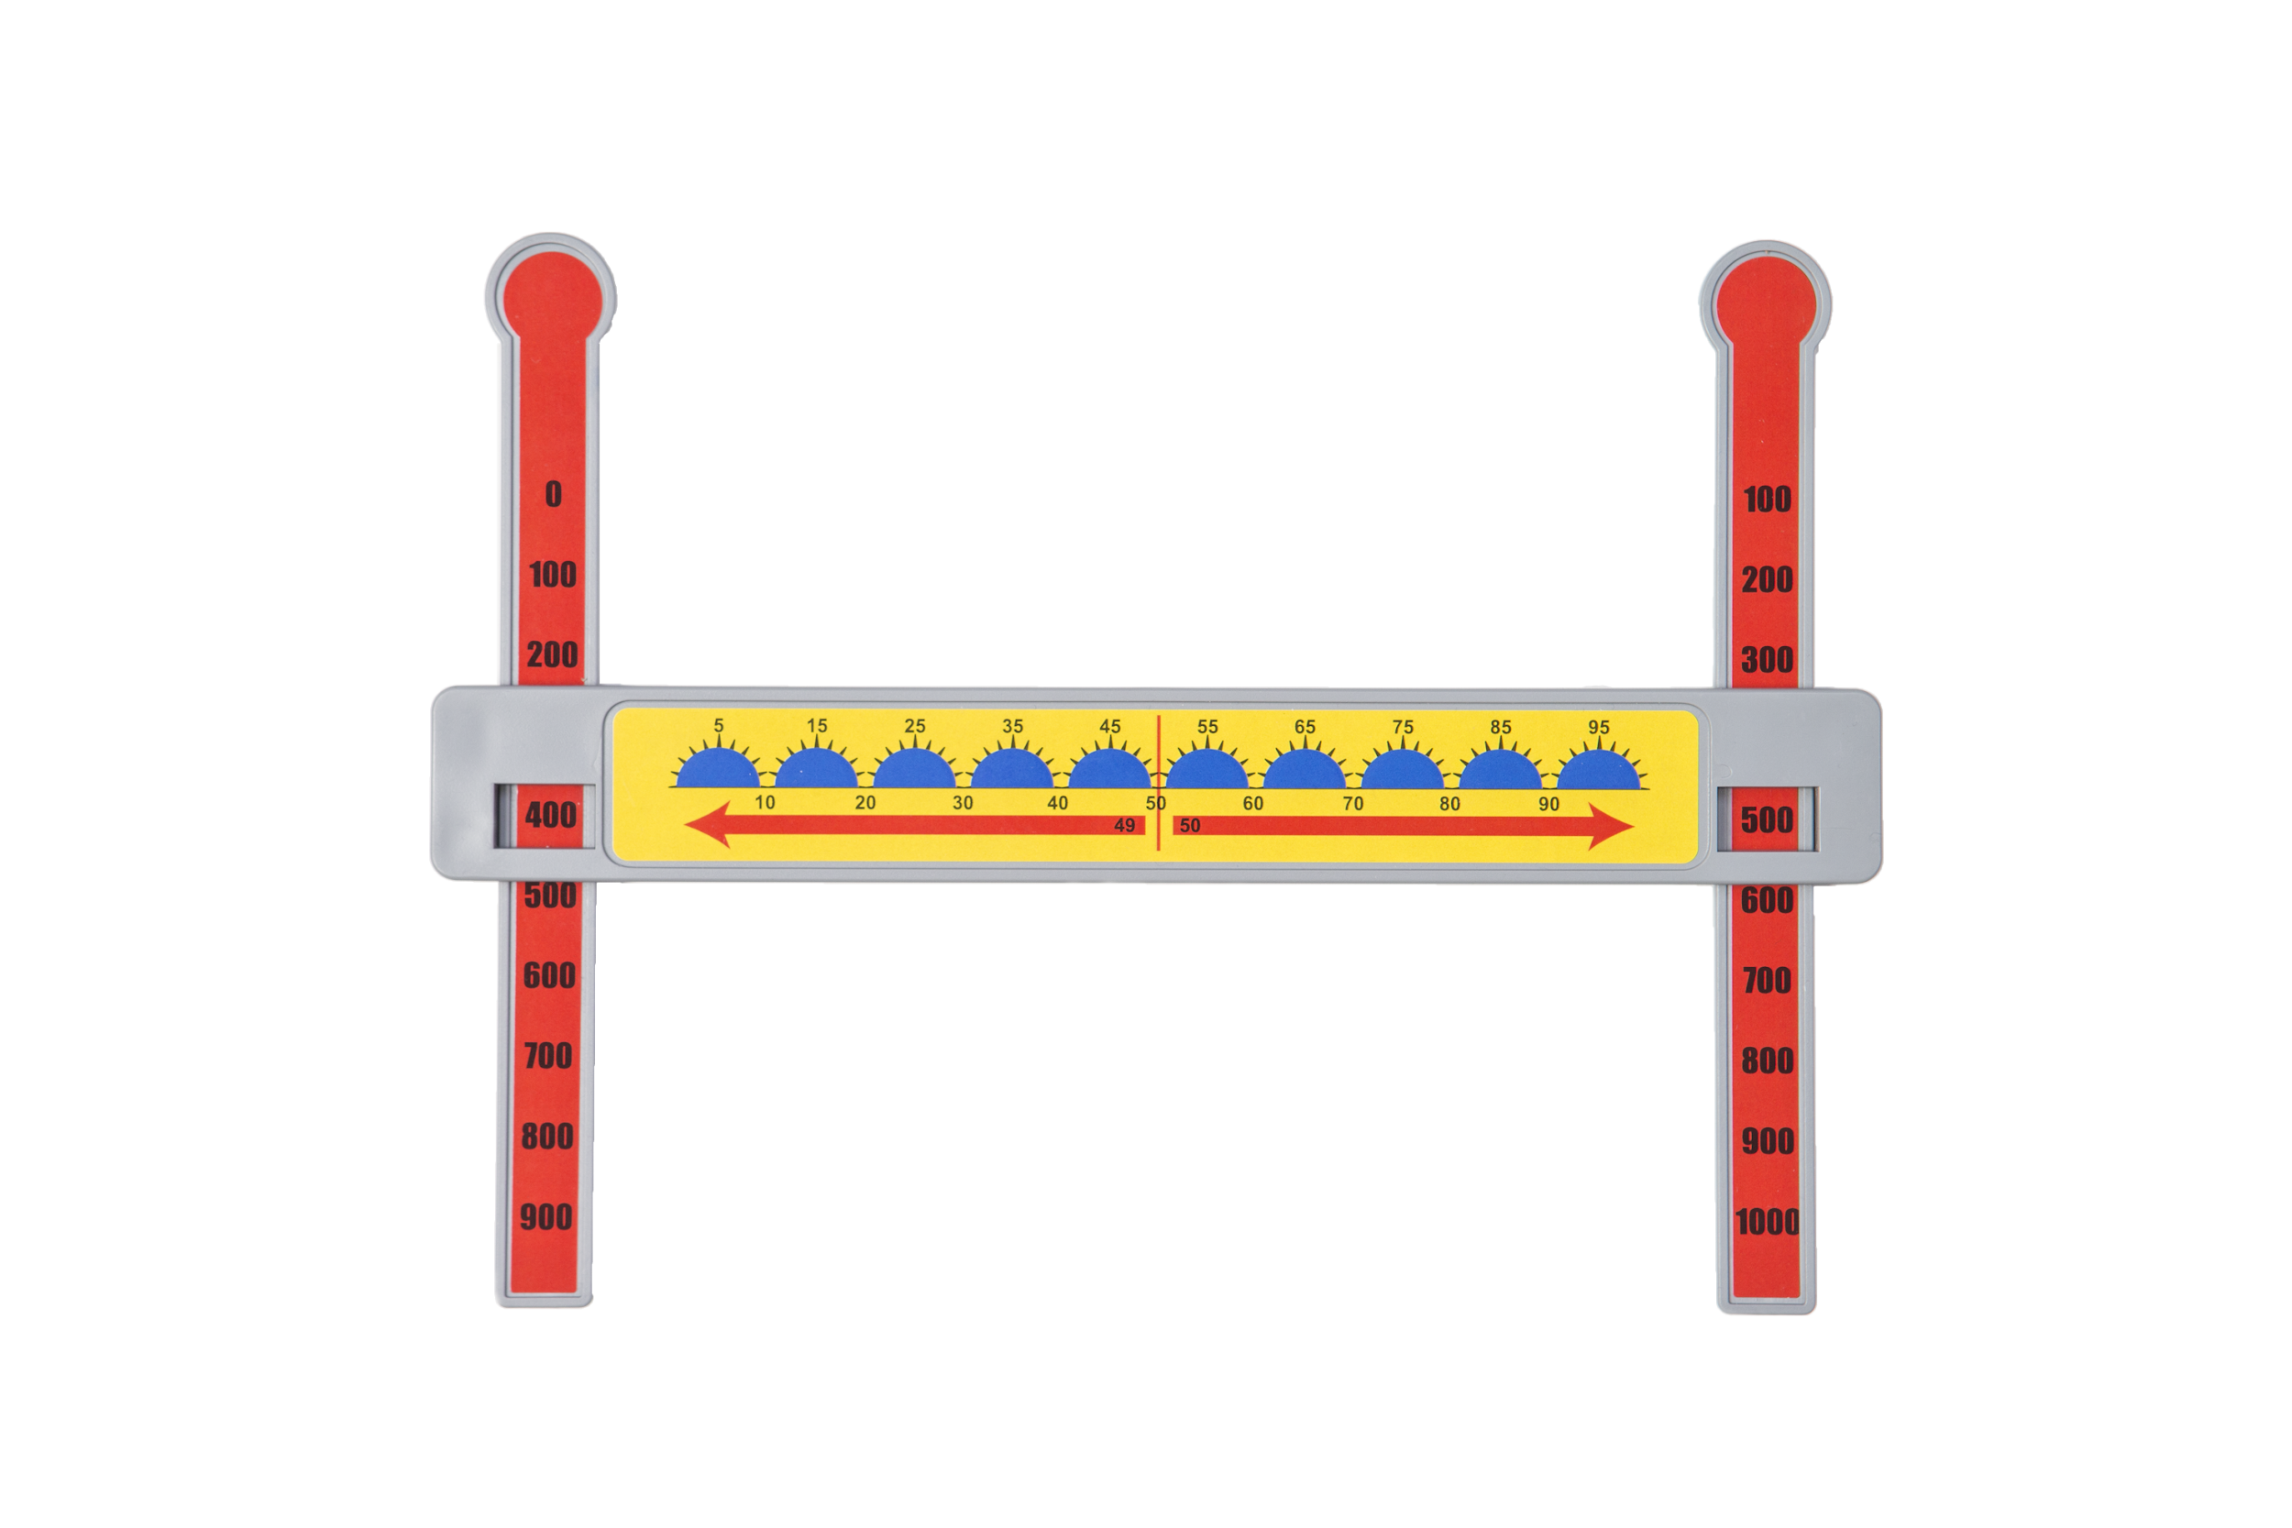
100X Math Manipulative - Rounds 10s & 100s
Round each number to the nearest ten.
994______________
Round each number to the nearest hundred.
189______________

Slide 7
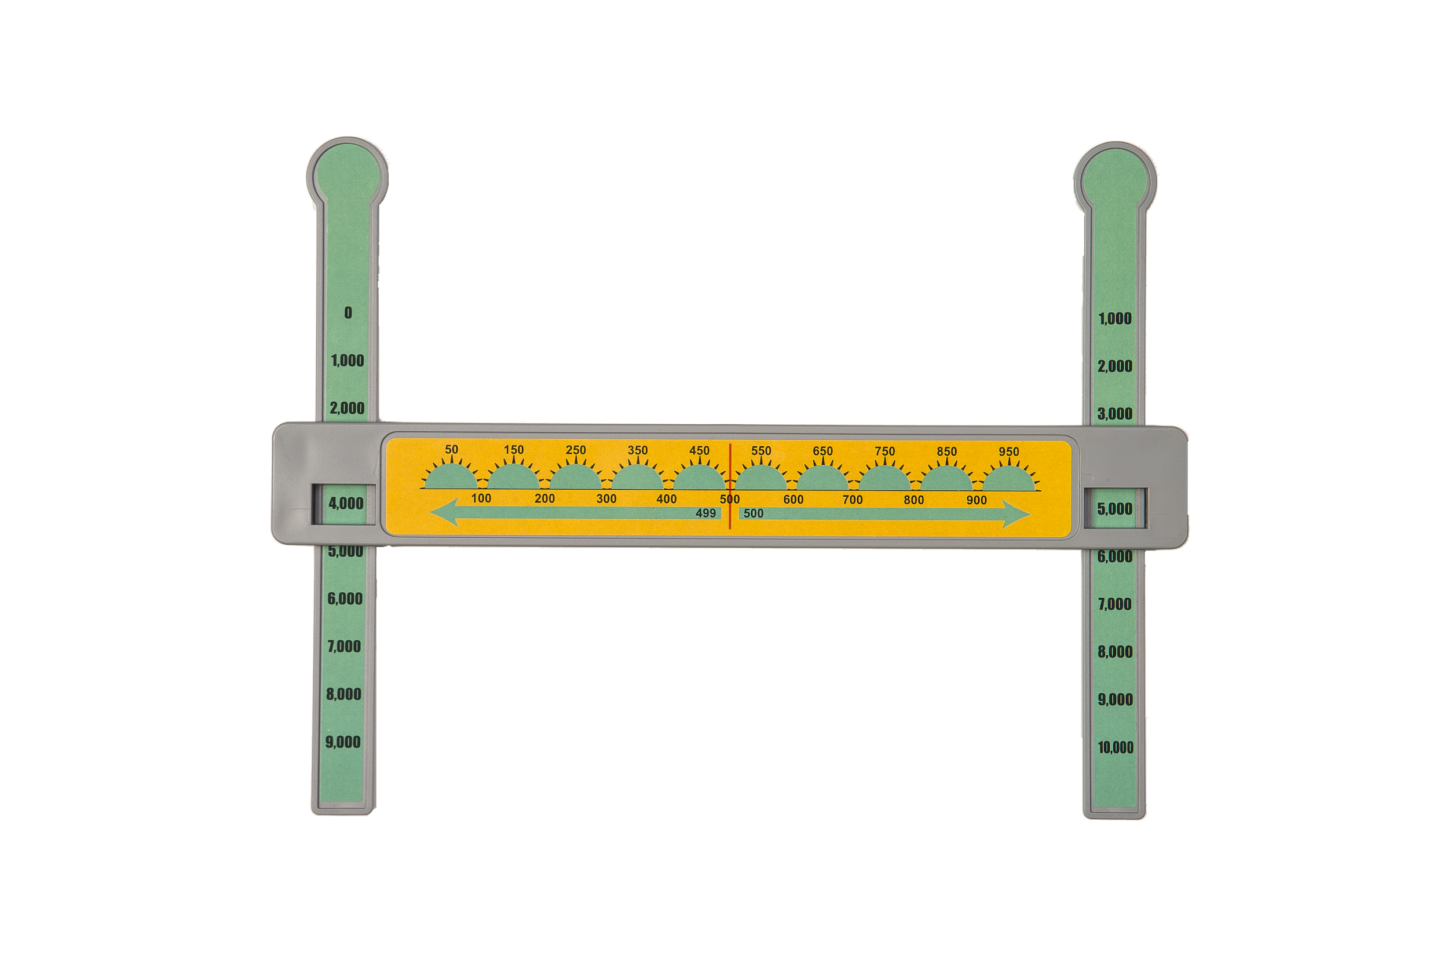
1,000X Math Manipulative - Rounds 100s & 1,000s
Round each number to the nearest hundred.
2,714____________
Round each number to the nearest 1,000.
5,243____________

Slide 8
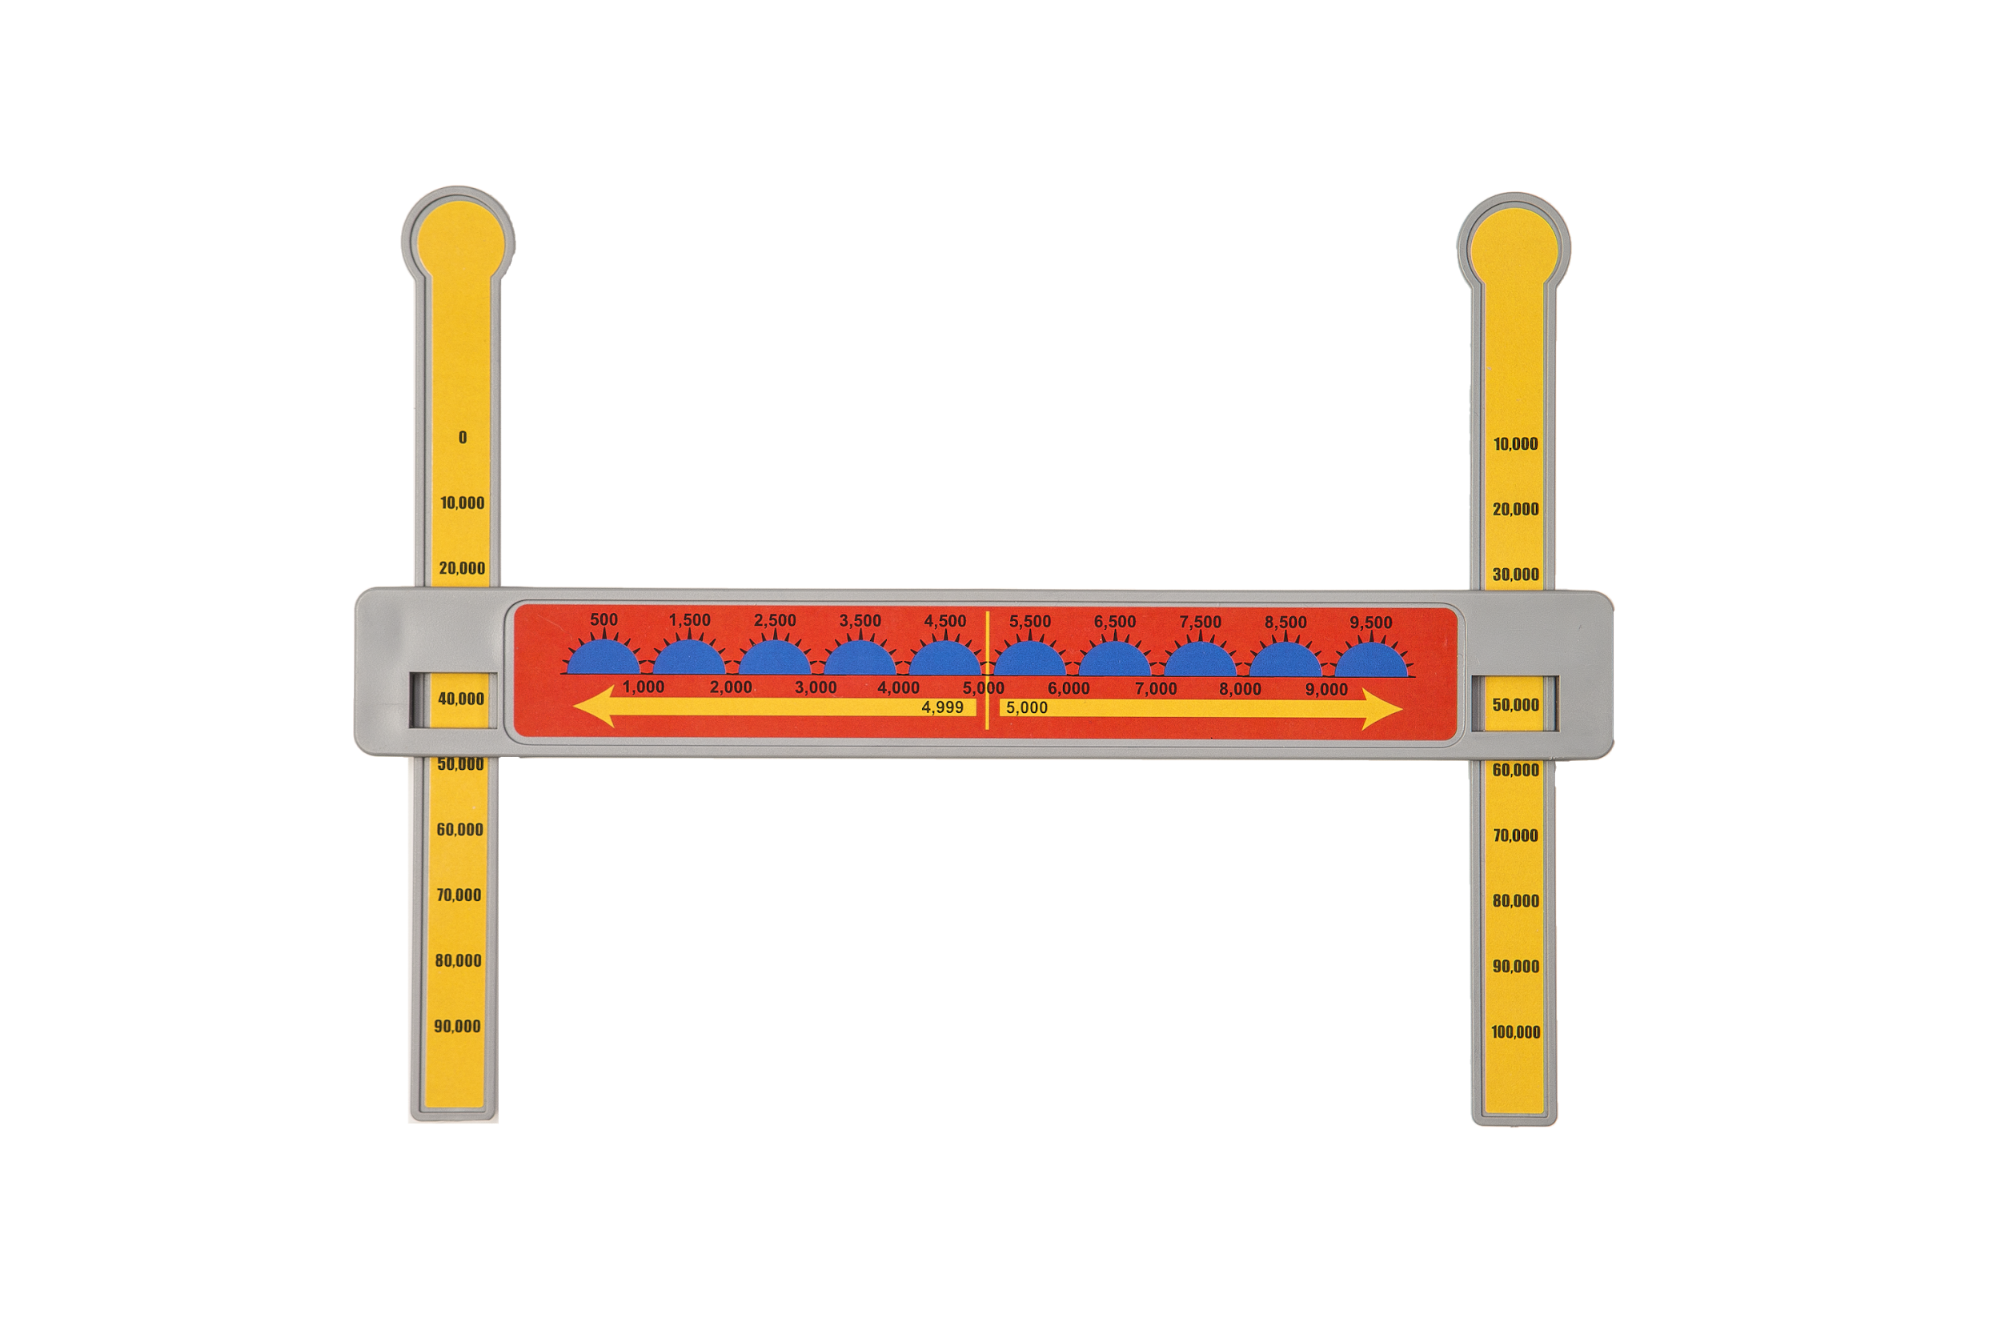
10,000X Math Manipulative - Rounds 1,000s & 10,000s
Round to the nearest 1,000.
43,241__________
Round to the nearest 10,000.
87,533__________

Slide 9
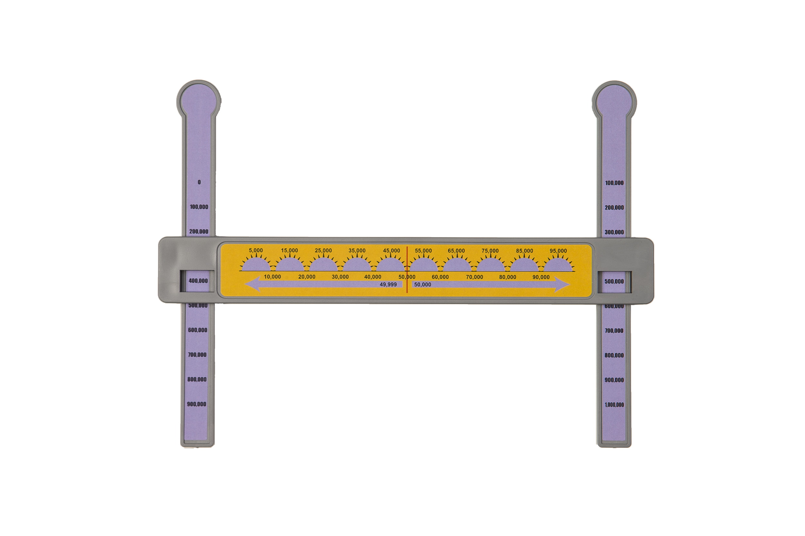
100,000X Math Manipulative - Rounds 10,000s & 100,000s
Round to the nearest 10,000.
497,321__________
Round to the nearest 100,000
672,005___________________

Slide 10
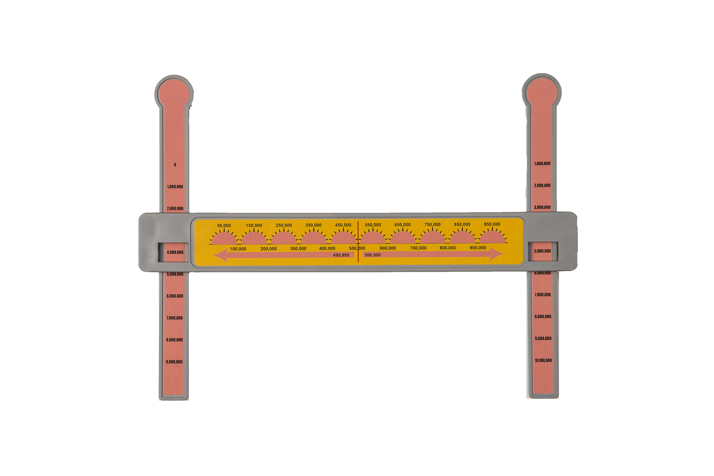
1,000,000X Math Manipulative - Rounds 100,000s & 1,000,000s
Round each number to the nearest million.
7,648,123 ____________ 1,328,985 ______________
9,721,245 ____________ 4,818,719 ______________
4,818,719 __________________

Slide 11
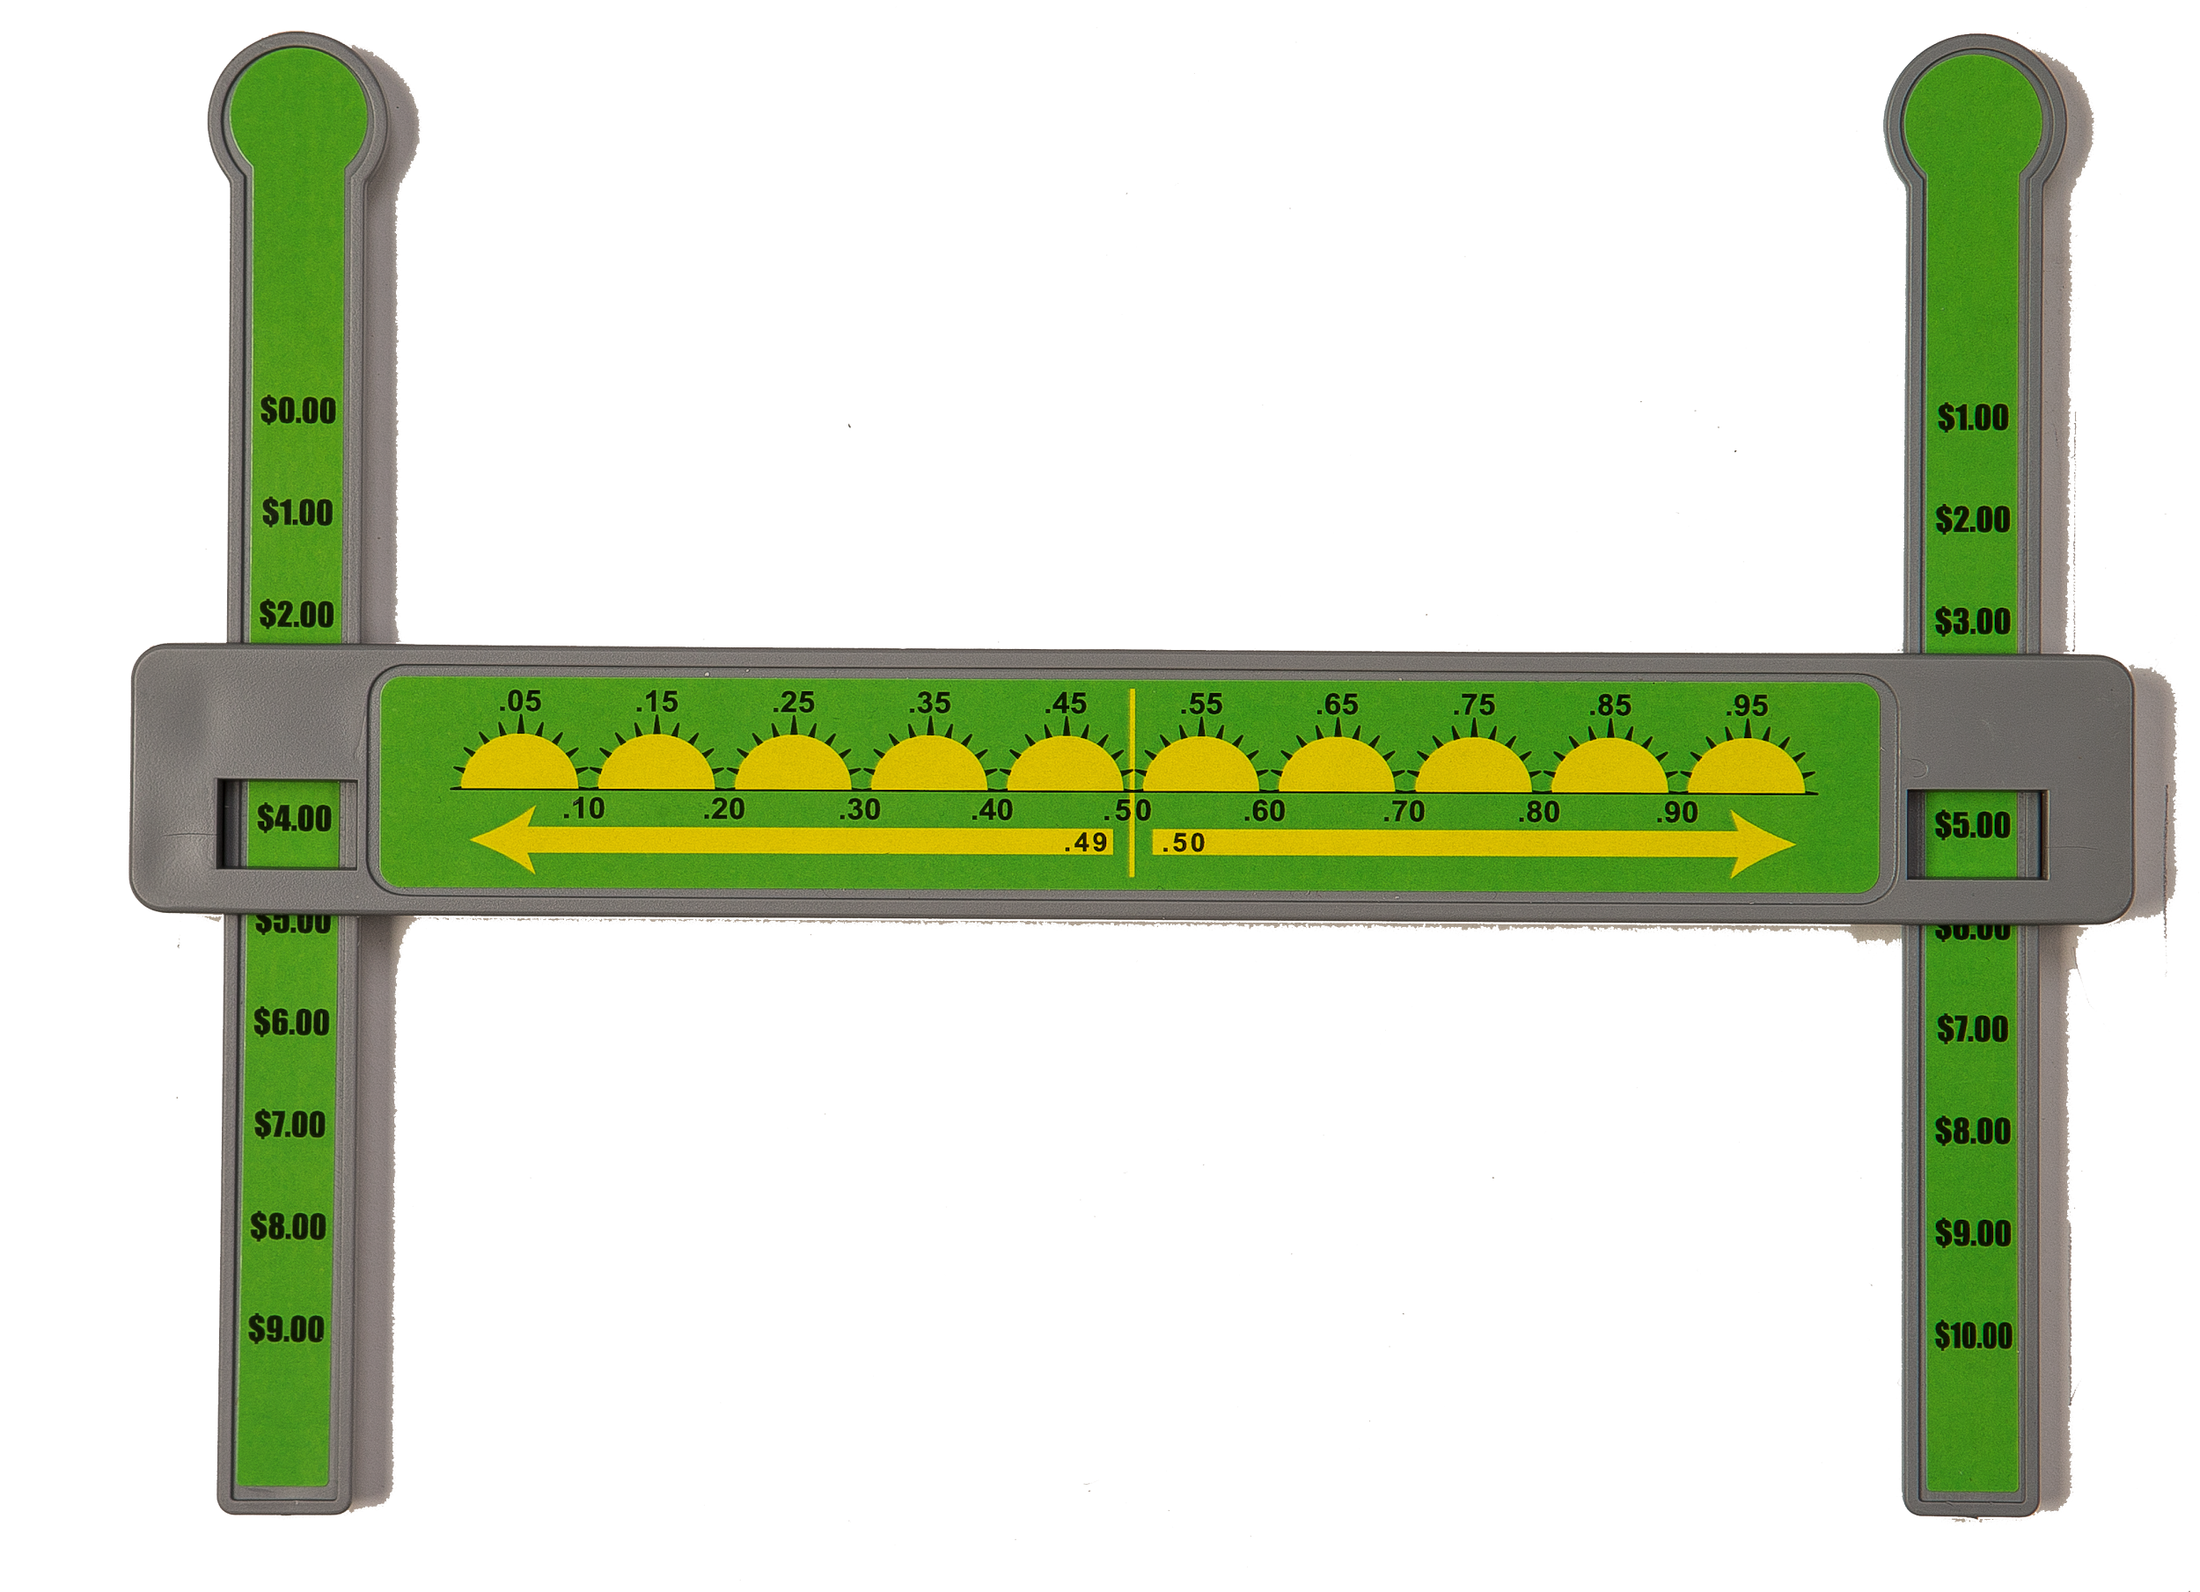
Money Math Manipulative - Rounds to the nearest dollar
Jimmy has $2.87. How much money does he need to have to reach $3.00?
○ $1.13 ○ $13.00
○ $0.13 ○ $31.00

Slide 12
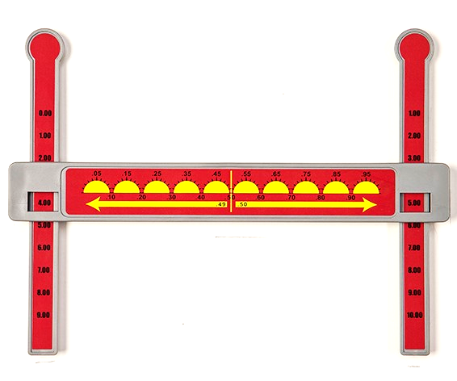
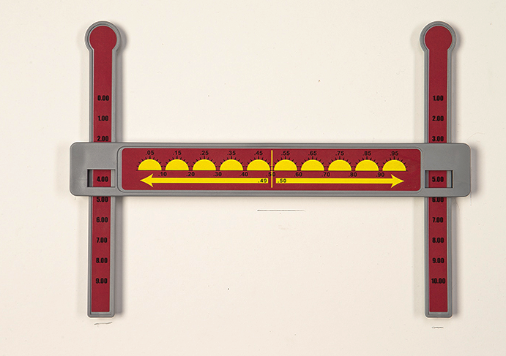
Decimal Math Manipulative - Rounds to the nearest tenth & whole number
https://www.youtube.com/watch?v=FcMf3y4J_Yo
Round 6.13 to the nearest whole number__________
Round 7.88 to the nearest tenth__________

Slide 13
What strategies do you have to teach fractions?
How do you differentiate teaching fractions?
How do you teach your students adding and subtracting fractions?
What do you do when a visual model is not enough?

Slide 14
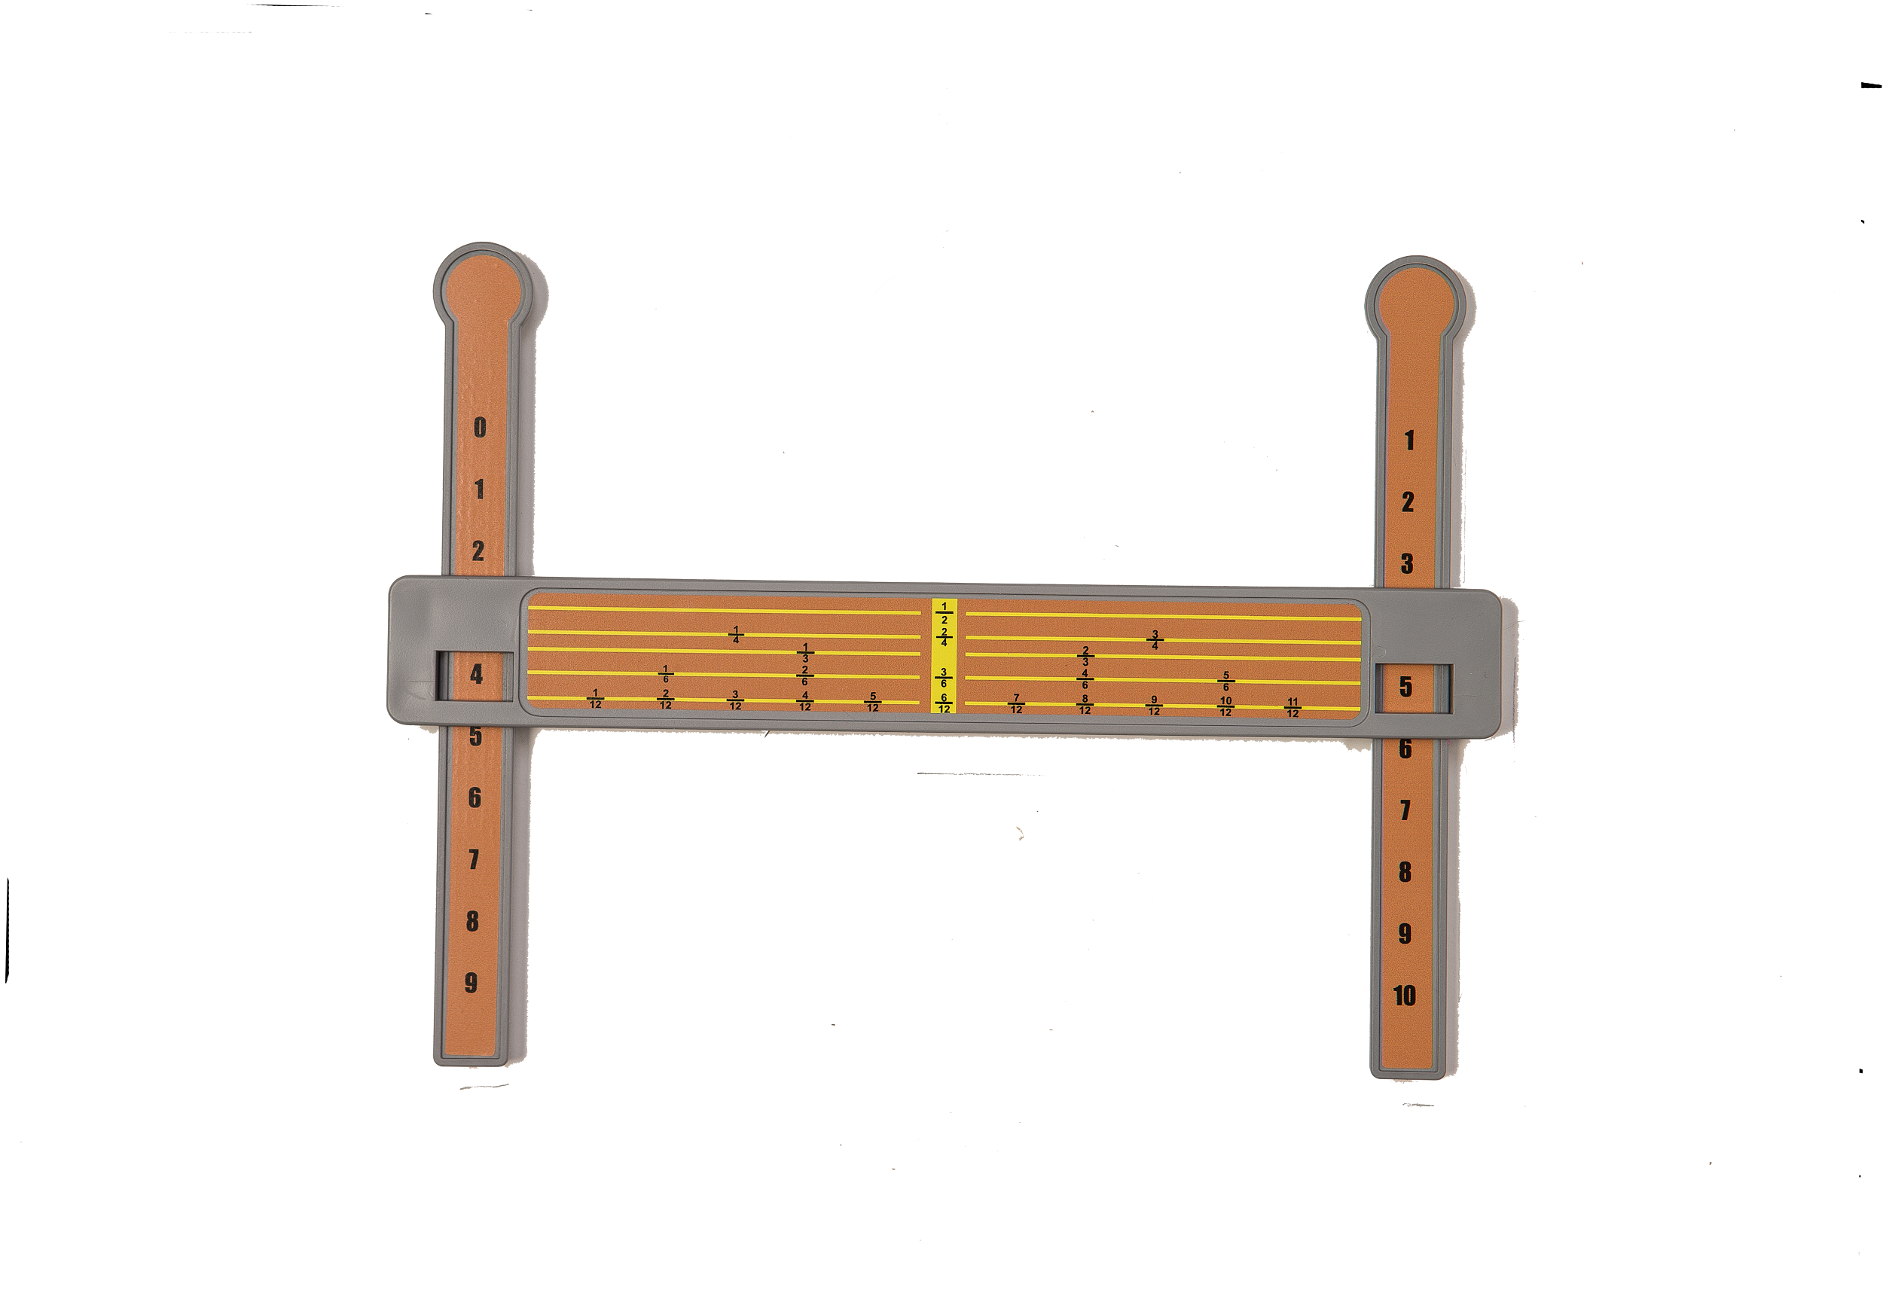
Fraction 12ths Math Manipulative - Compare, +/- fractions with common and uncommon denominators & reduce/simplify
Which fraction is less than 2/3? How many 1/6ths equal 1/2?
○ 4/6 ○ 1
○ 5/6 ○ 2
○ 8/12 ○ 3
○ 7/12 ○ 4

Slide 15
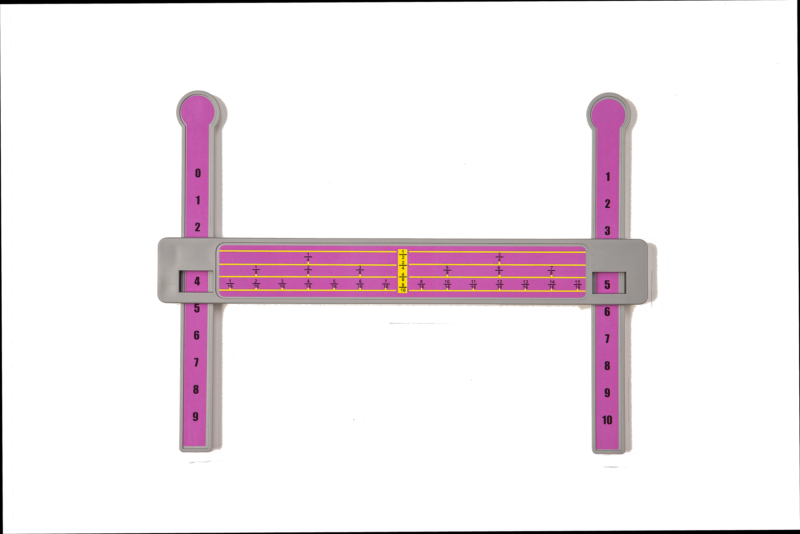
Fraction 16ths Math Manipulative - Compare, +/- fractions with common and uncommon denominators & reduce/simplify
5 ⅞ – 6/16 = Which fraction below is a simplified fraction equal to
○ 5 ½ 6/8?
○ 5 2/16 ○ 1/2
○ 4 ⅞ ○ 1/8
○ 5 ¼ ○ ¾
○ 11/16

Slide 16
Fractions Resources & Links
Oklahoma Fractions Article
Fractions Help Sheet
Fractions Instructional Rubric

Slide 17
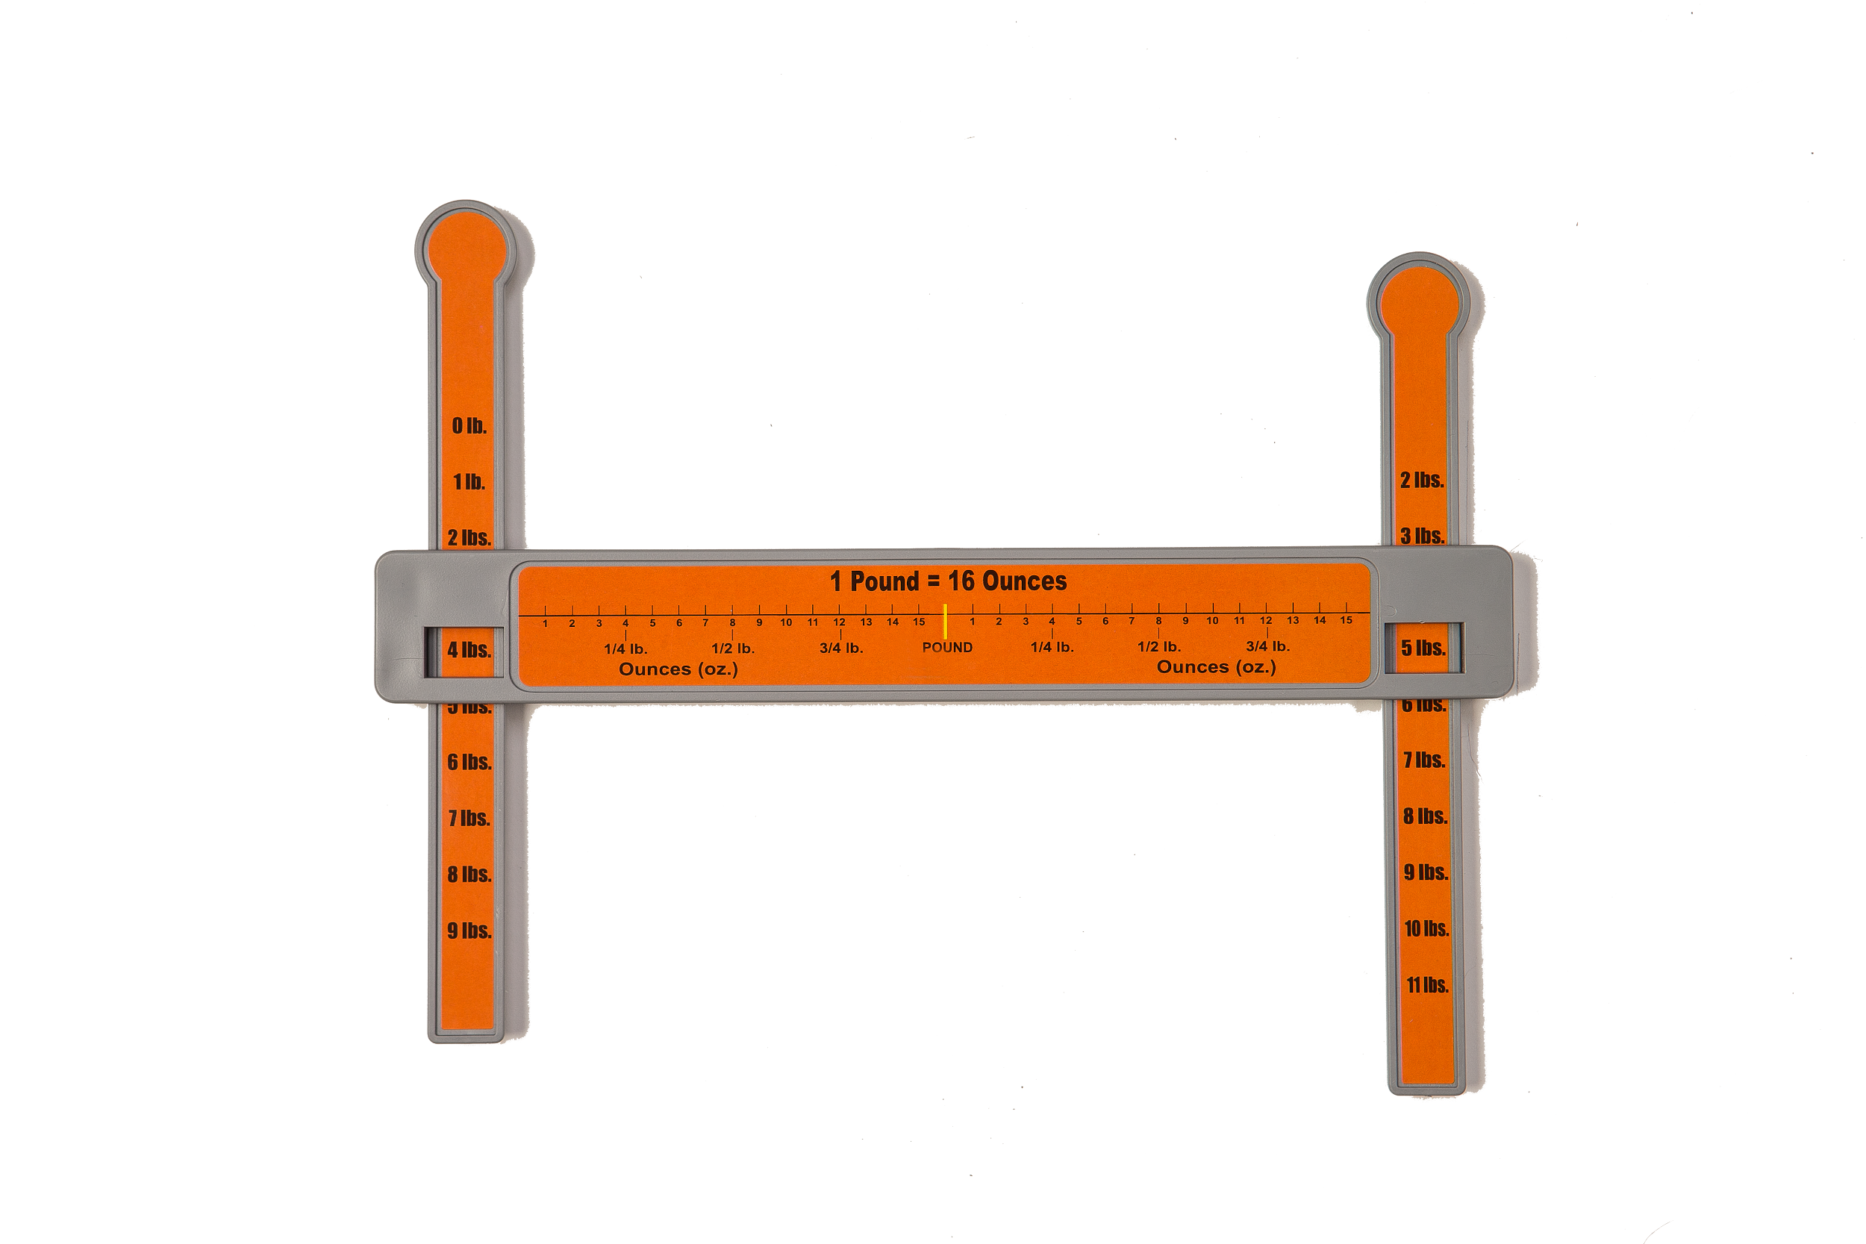
Weight Math Manipulative - +/- ounces & pounds in measurement
Sarah Kate has 5 lbs. of potatoes. She uses ½ lb. over the weekend in a casserole. How many pounds of potatoes does she have left?
○ 4 lbs. 8 oz.
○ 4 1/2 lbs.
○ 5 ½ lbs.
○ Both A & B

Slide 18
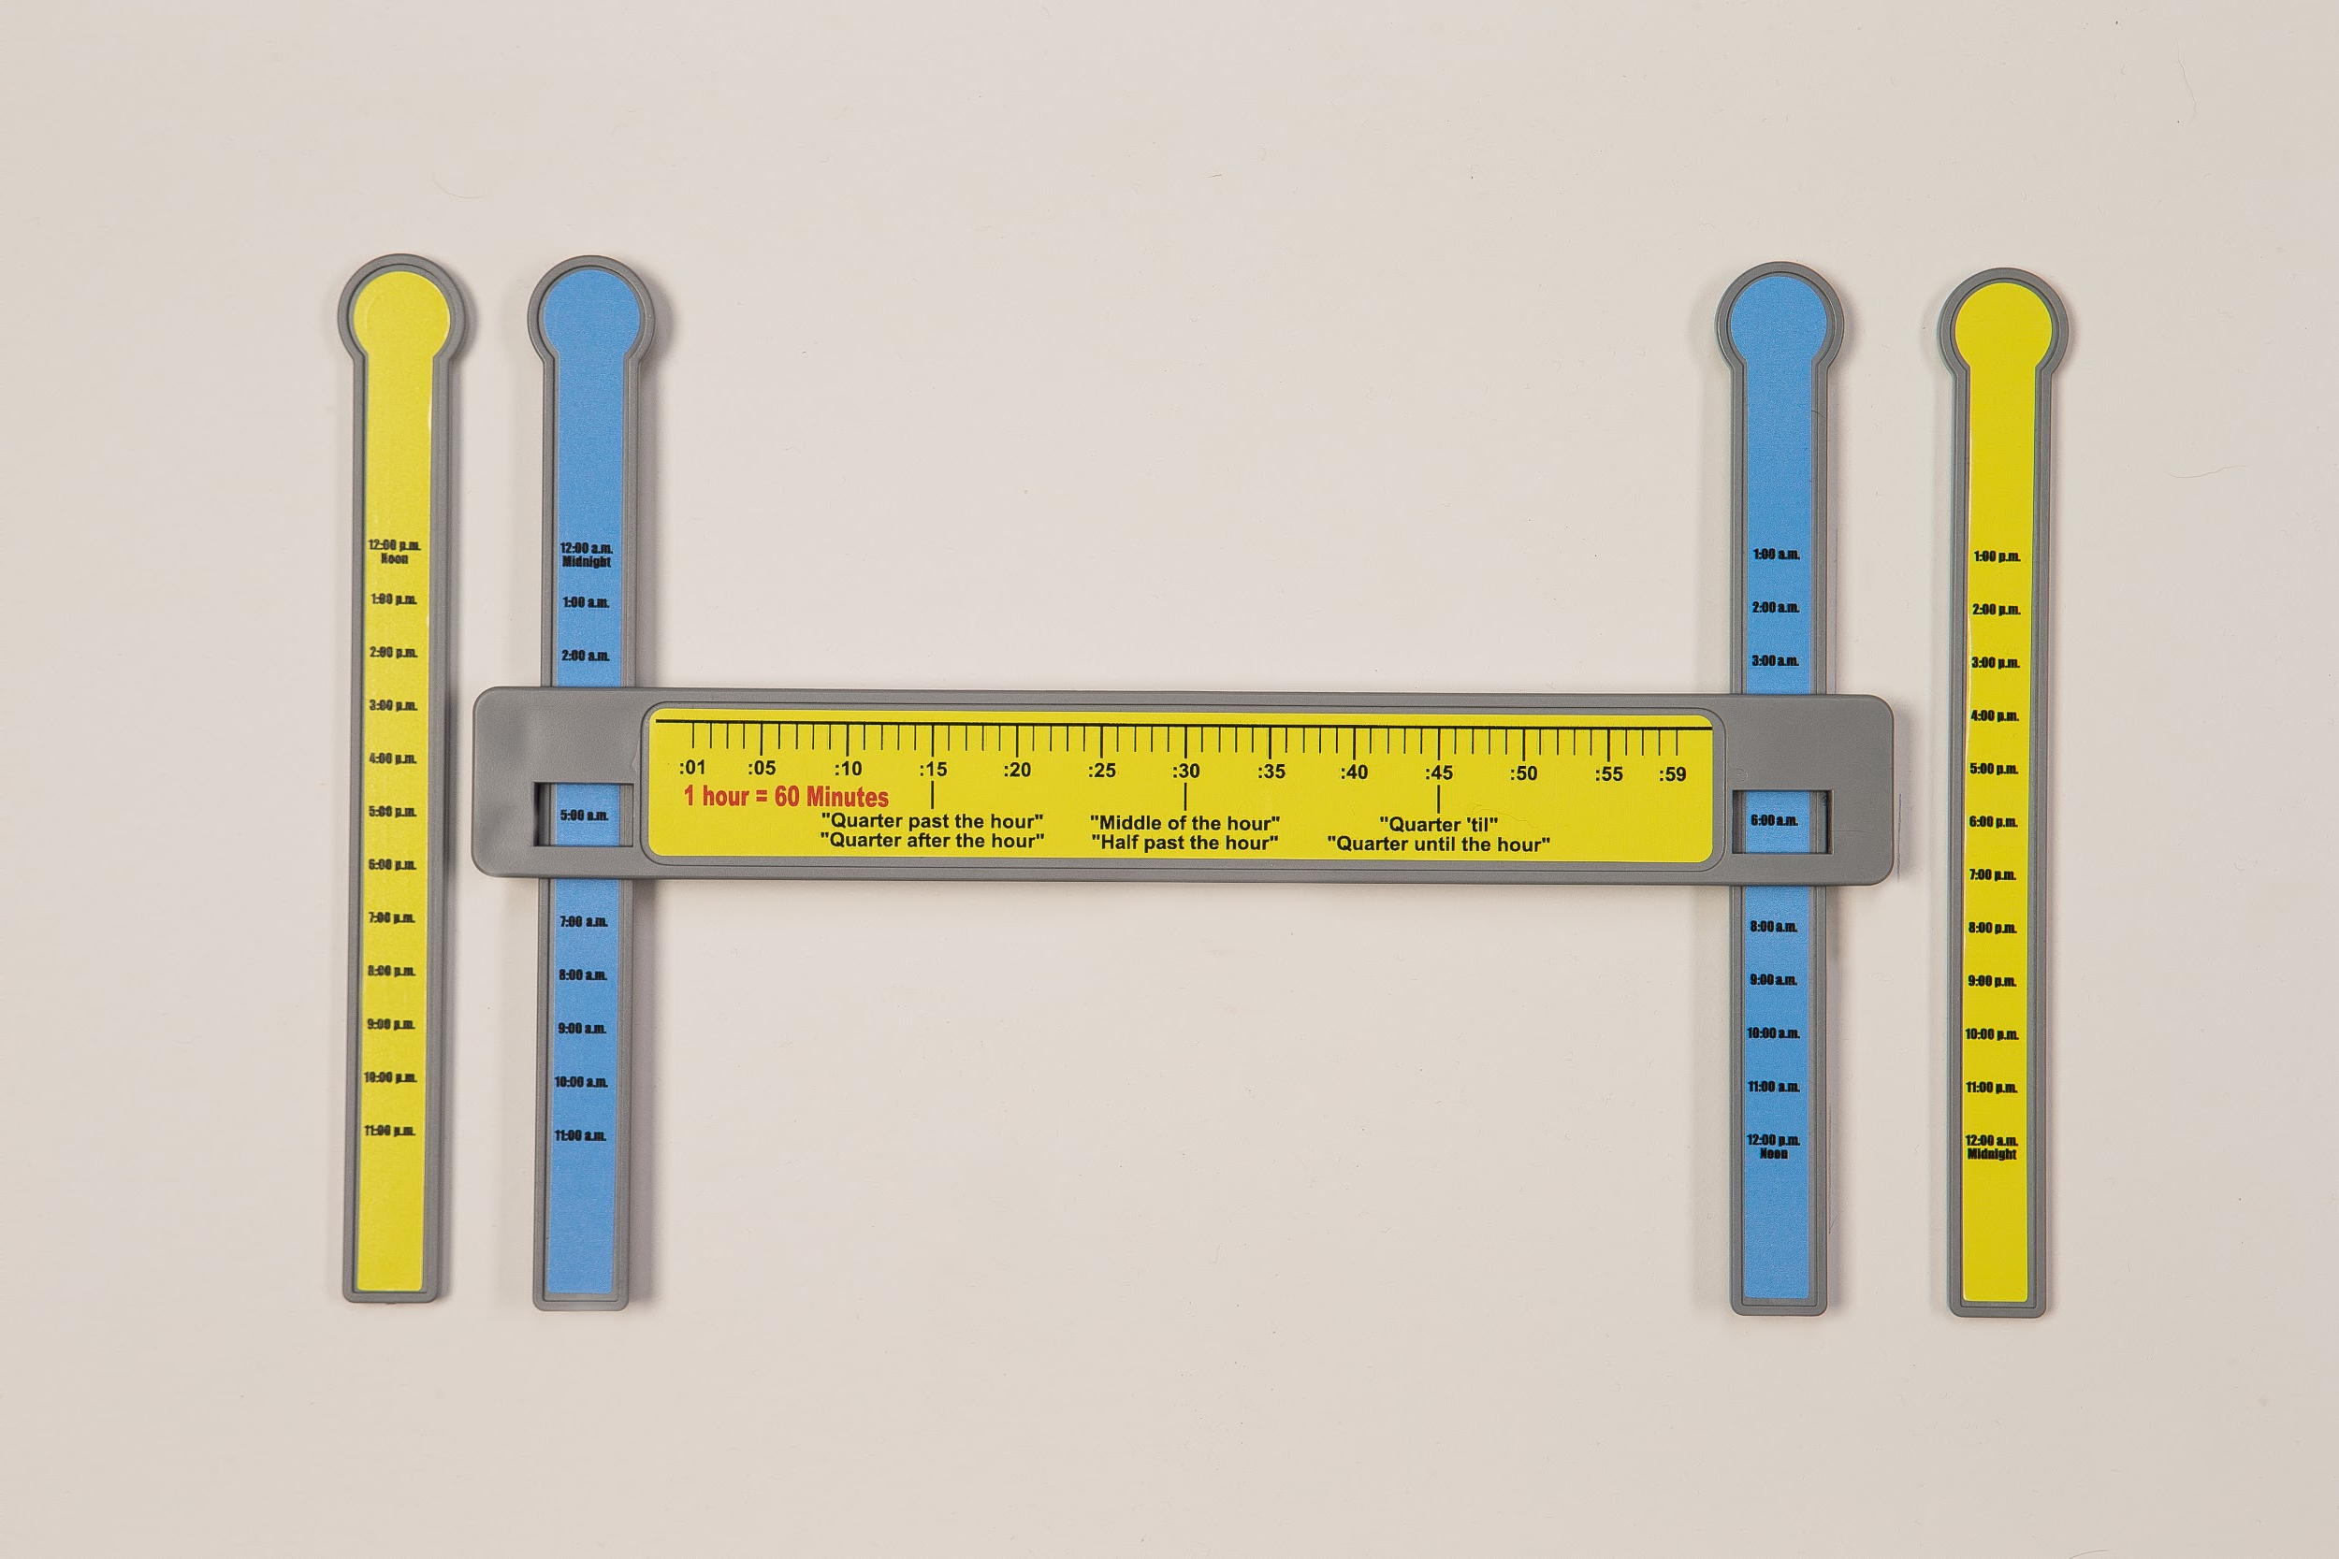
Elapsed Time Math Manipulative - +/- minutes and hours to solve word problems
It is now 9:25. What time will it be in 20 minutes?
○ quarter till 10:00
○ 9:45
○ 9:55
○ two answers are correct

Slide 19
Website Information with Links to Published Articles
www.slidearoundmath.com
Demonstration Videos:
https://www.eastersealstech.com/2015/11/30/monday-tech-tip-math-manipulatives/
https://drive.google.com/file/d/1BhLQEJh38UjlQzyVVD3KAq1MiHQmiS3P/view?usp=drive_link

Slide 20
PATINS Project Demonstration Video Link
https://youtu.be/ewdnqgyN9iM

Slide 21
Slide-A-Round Math Order Form
https://drive.google.com/file/d/1sWMkyOABrRgZS5EErU5lnq_SNn4ueSJv/view?usp=sharing

Slide 22
Questions? Answers? Feedback?
Thanks for your time and participation! I know this is A LOT of information to receive in one session, so when you have some time, I want you to search “rounding math manipulatives” to see just what is actually available to support you in teaching these math standards to your students. I am happy to answer any questions you may have. Thanks again, Jim

